Slide 1
More Than a Lottery : Retraining the Lottery Ticket Hypothesis
Supervisor : Prof. Jiaul Hoque Paik
Presented by : Kushagra Chitkara
Roll Number : 19EE10036

Slide 2
What is the Lottery Ticket Hypothesis?
Proposed by MIT Researchers in 2018
Wanted to prune a neural network without losing out on accuracy
Pruning is done to save up on time and memory resources
Were able to prune 94% of the network parameters
Christened these sparse subnetworks as 'winning tickets'

Slide 3
Issues with their methodology
Authors pruned weight parameters, instead of entire neurons
The matrix being fed to GPU is sparse but still huge
GPU calculations not as efficient

Slide 4
Our proposal
Instead of pruning weights, we wish to prune entire neurons
We will use k-DPP methods to identify 'best' neurons
Instead of re-initialising and pruning until convergence, we will prune and retrain the condensed model

Slide 5
Architecture Used
Feed-Forward Neural Network
We take inspiration from Lottery Ticket's architecture
Why FMNIST?
Batch Size 32
ReLU after each layer
NLL Loss Function
50 epochs
Learning rate 0.0003
F-MNIST Dataset
784 - 300 - 100 - 10
Inspired by Lottery Ticket's architecture

Slide 6
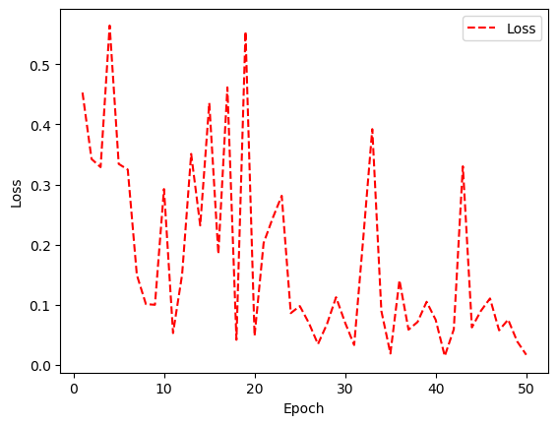
Architecture Used
Feed-Forward Neural Network
We take inspiration from Lottery Ticket's architecture
Why FMNIST?
Adam Optimiser
50 epochs
Learning rate 0.0003
F-MNIST Dataset
Loss stabilises at around 50 epochs
784 - 300 - 100 - 10
Inspired by Lottery Ticket's architecture

Slide 7
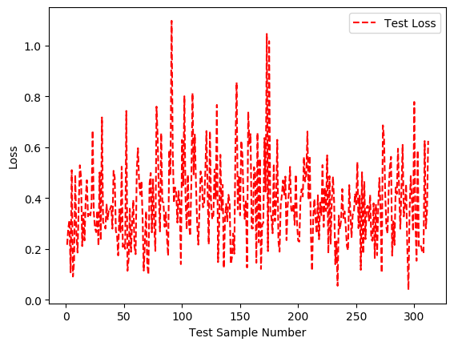
Initial Values
After 50 epochs :
Net Testing Loss:
12.933
Accuracy:
8705/9984 = 87.19%
Batch loss vs Batch Number

Slide 8
How to choose best neurons?
The neurons we seek should satisfy two properties
Considerable contribution
Diverse
Enter k-DPP

Slide 9

Determinental Point Process
Proposed by Alex Kulesza and Ben Taskar in 2012
We create a K-by-K kernel matrix L, where L[i][j] = f(a_{i} , a_{j})
We wish to find a subkernel based on the following probability :

Slide 10
How does it work?
To maximise p(Y), det(L_{Y}) must be maximised
In the given matrix a₁a₄ must be greater than a₂a₃
If a₁ and a₂ are of similar scale, the net determinant goes to zero

Slide 11
Describing our Kernel
We develop two kernels, one for each hidden layers
For a layer with n neurons, kernel L is of size n-by-n
L[i][j] = q_{i} . C_{i,j} . q_{j}
q_{i} = quality of neuron, average activation values
C_{i,j} = correlation between i-th and j-th neuron vectors
Pearson correlation coefficient is used

Slide 12
How to use DPP?
Output is an array with indexes of 'best' neurons
Apply DPP on each layer
Prune 75% neurons in each layer
New architecture is 784 - 75 - 25 - 10
Test this pruned network
Use same weights of new network, retrain, and test

Slide 13
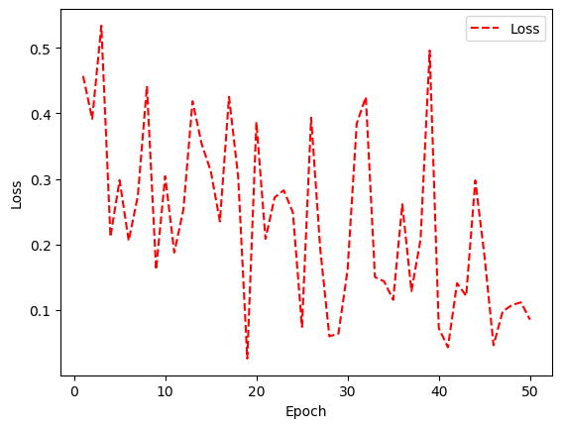
How to use DPP?
Output is an array with indexes of 'best' neurons
Apply DPP on each layer
Prune 75% neurons in each layer
New architecture is 784 - 75 - 25 - 10
Test this pruned network
Use same weights of new network, retrain, and test
Even here, training loss stabilises at around 50 epochs

Slide 14
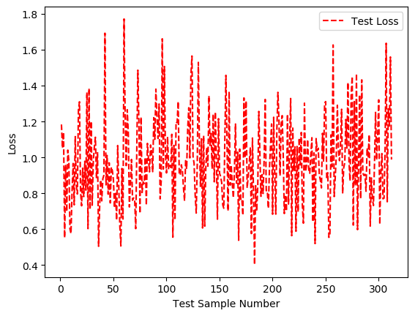
Results
Without retraining our model :
Net Testing Loss:
31.258
Accuracy:
6683/9984 = 66.93%
Batch loss vs Batch Number

Slide 15
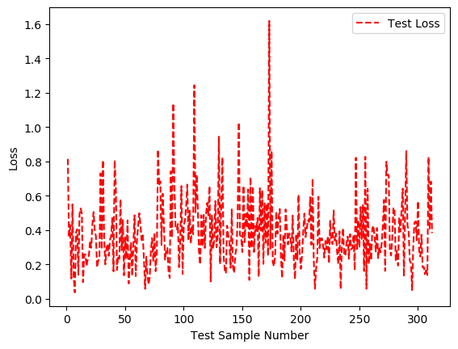
Results
After retraining our model :
Net Testing Loss:
12.180
Accuracy:
8778/9984 = 87.9%
Batch loss vs Batch Number

Slide 16
Can we prune further?
We wanted to check the extent to which we could prune
No significant loss in accuracy should be observed
Upon further pruning the MLP network, we observe no significant loss in accuracy is observed until the network is 99% pruned

Slide 17
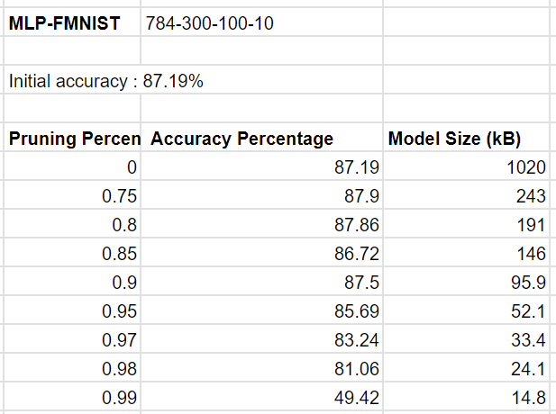
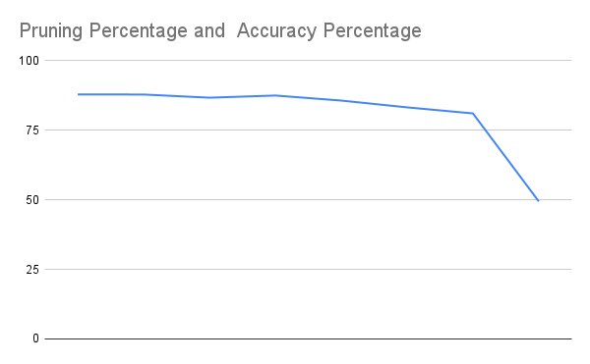
Results

Slide 18
Key Takeaways
Simply pruning the network is not so effective
A roughly 20% drop in accuracy
Retraining changes this dramatically
New accuracy as good as initial values
A 'winning network' exists for at least 25% sparse network

Slide 19
Future Work
Check if training time is reducing
Experiment with DPP kernel
Experiment with different types of neural networks
Experiment with various datasets

Slide 20


